Slide 1
Lab 6
Light Intensity & Distance
Daksh Khandelwal

Slide 2
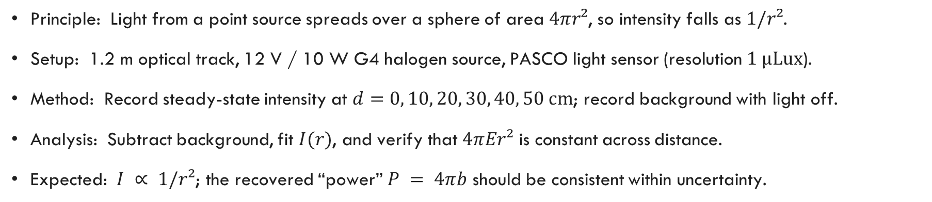
Objective and Experiment
Determine how detected light intensity from a “point” source varies with distance, and check whether the inverse-square law $I=P/\left(4πr^{2}\right)$ holds.
Principle: Light from a point source spreads over a sphere of area $4πr²$, so intensity falls as $1/r²$.
Setup: 1.2 m optical track, 12 V / 10 W G4 halogen source, PASCO light sensor (resolution $1 µLux$).
Method: Record steady-state intensity at $d=0, 10, 20, 30, 40, 50 cm$; record background with light off.
Analysis: Subtract background, fit $I(r)$, and verify that $4πEr²$ is constant across distance.
Expected: $I ∝ 1/r²$; the recovered “power” $P = 4πb$ should be consistent within uncertainty.

Slide 3
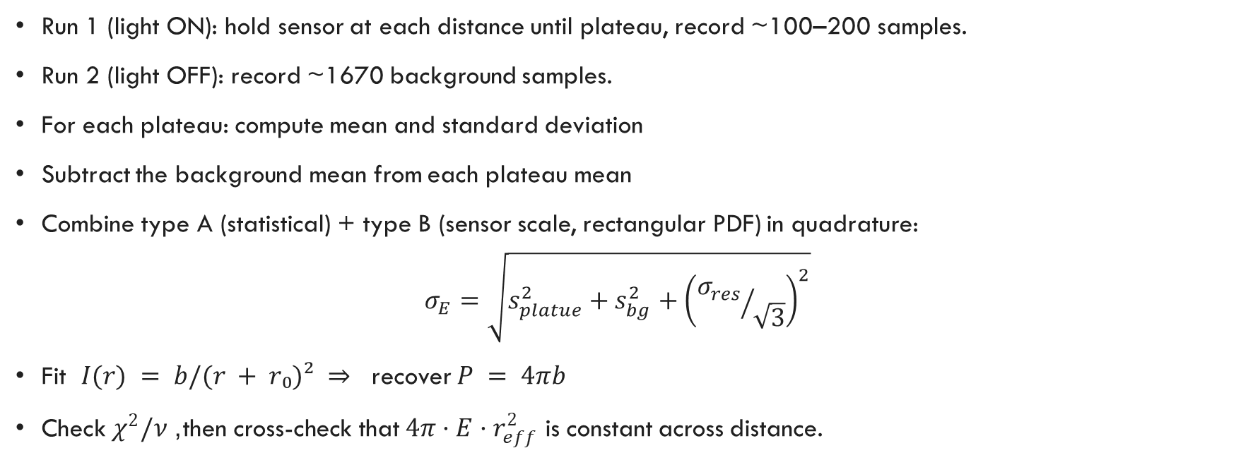
Method
Run 1 (light ON): hold sensor at each distance until plateau, record ~100–200 samples.
Run 2 (light OFF): record ~1670 background samples.
For each plateau: compute mean and standard deviation
Subtract the background mean from each plateau mean
Combine type A (statistical) + type B (sensor scale, rectangular PDF) in quadrature:
$$σ_{E}=\sqrt{s_{platue}^{2}+s_{bg}^{2}+{\left({σ_{res}}/{\sqrt{3}}\right)}^{2}}$$
Fit $I(r) = b/(r + r₀)² ⇒$ recover $P = 4πb$
Check $χ^{2}/ν$, then cross-check that $4π·E·r_{eff}^{2}$ is constant across distance.

Slide 4
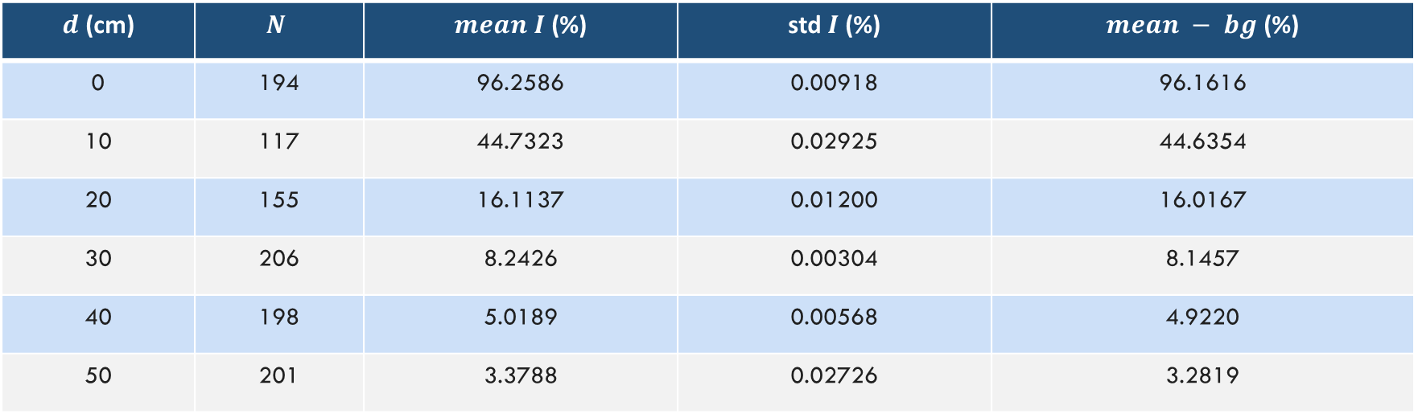
Data and Measurements
Plateau means (Run 1) and standard deviations at each distance, with background subtracted (mean of Run 2 = 0.0969%).
$d$ (cm) | $$N$$ | $mean I$(%) | std$I$(%) | $mean − bg$(%)
0 | 194 | 96.2586 | 0.00918 | 96.1616
10 | 117 | 44.7323 | 0.02925 | 44.6354
20 | 155 | 16.1137 | 0.01200 | 16.0167
30 | 206 | 8.2426 | 0.00304 | 8.1457
40 | 198 | 5.0189 | 0.00568 | 4.9220
50 | 201 | 3.3788 | 0.02726 | 3.2819
Background (Run 2): $N = 1669$, $mean= 0.0969\%,$ $s = 0.0012\%$(Gaussian).
Distance uncertainty: $σ_{r}=5 mm/\sqrt{3}≈2.9 mm$ (rectangular PDF; ruler resolution + endpoint).
Sensor resolution $σ_{res}$: $1 × 10⁻⁶ Lux$(rectangular PDF) — negligible vs plateau std.

Slide 5
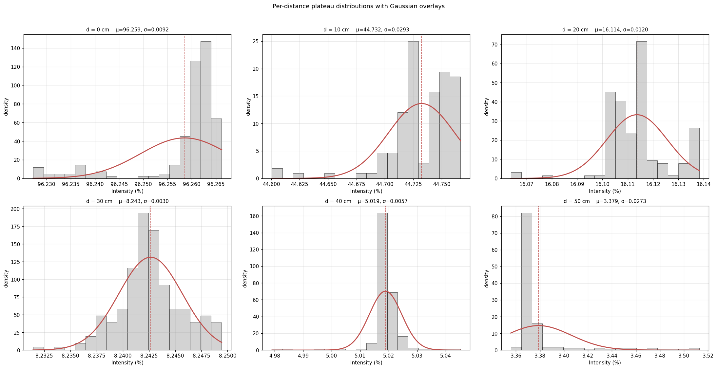
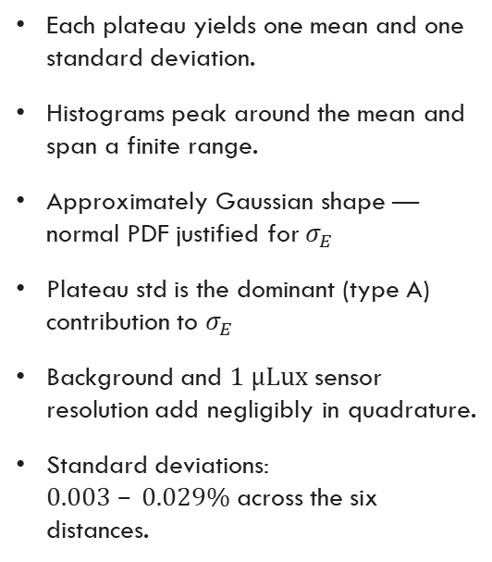
Per-Distance Distributions
Each plateau yields one mean and one standard deviation.
Histograms peak around the mean and span a finite range.
Approximately Gaussian shape — normal PDF justified for $σ_{E}$
Plateau std is the dominant (type A) contribution to $σ_{E}$
Background and $1 µLux$ sensor resolution add negligibly in quadrature.
Standard deviations: $0.003 – 0.029\%$across the six distances.

Slide 6
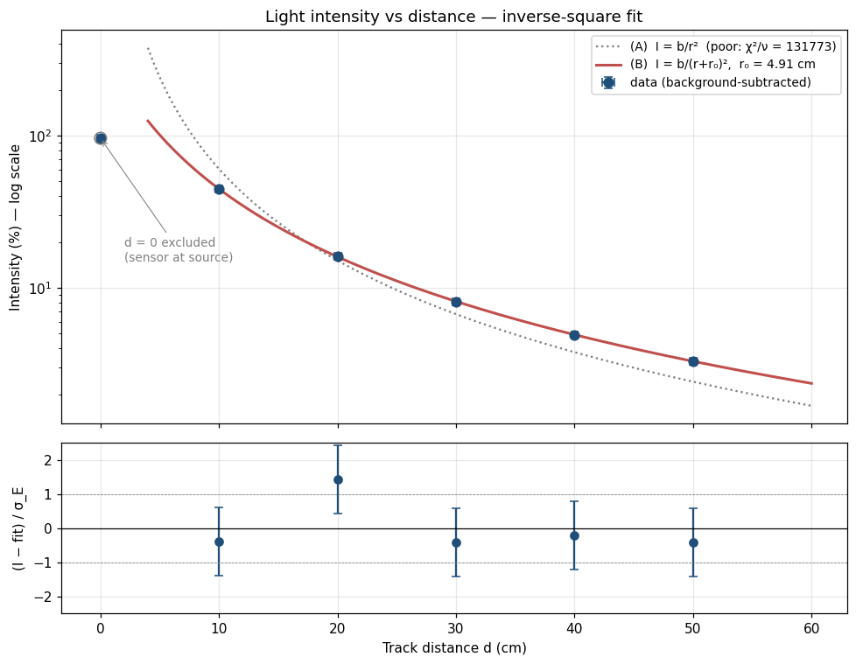
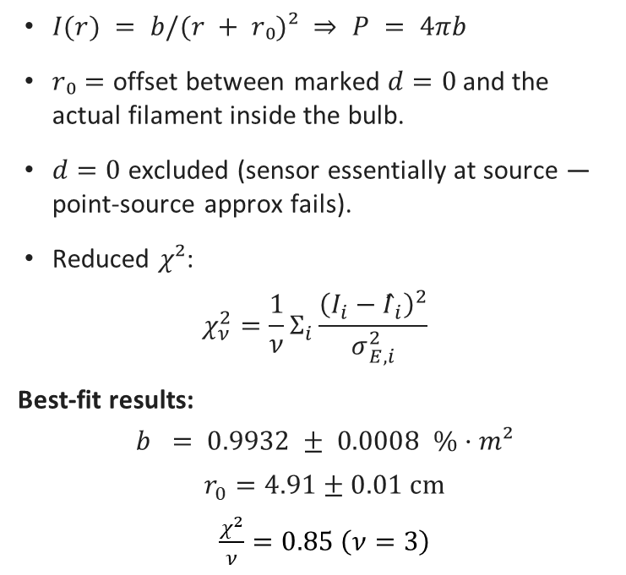
Inverse-Square Fit
Fit form
$I(r) = b/(r + r₀)² ⇒$ $P = 4πb$
$r₀=$ offset between marked $d=0$ and the actual filament inside the bulb.
$d=0$ excluded (sensor essentially at source — point-source approx fails).
Reduced $χ²$:
$$χ_{ν}^{2}=\frac{1}{ν}Σ_{i}\frac{{\left(I_{i}−Î_{i}\right)}^{2}}{σ_{E,i}^{2}}$$
Best-fit results:
$$b = 0.9932 ± 0.0008 \%·m²$$
$r_{0}=4.91±0.01 cm$
$\frac{χ^{2}}{ν}=0.85 \left(ν=3\right)$

Slide 7


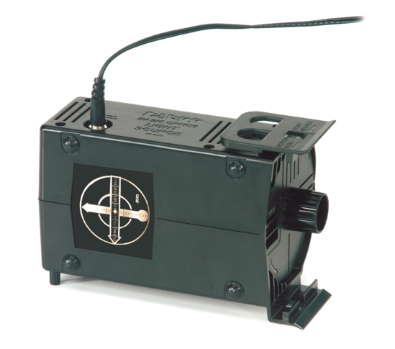

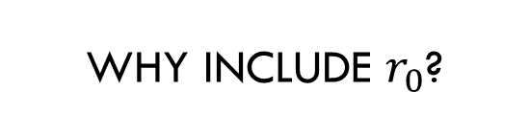
Why include $r_{0}$?
True distance form the source to sensor is $r=d+r_{0}$, where $r_{0}$ is the offset to be determined
It's the value that minimizes the weighted sum of squared residuals i.e., the fit that best balances all five data points ($d = 10, 20, 30, 40, 50 cm$) given their individual uncertainties.
The uncertainty $±0.01 cm$ comes from the covariance matrix that the fitter computes at the minimum quantifying the precision of the recovered parameter.
Evidence from data
Fitting $I=b/r^{2}$ gave $χ^{2}/ν≈131,773$ overestimating intensity at small distances and underestimating at large distances
Adding $r_{0}$ as a free parameter dropped $χ^{2}/ν=0.85$
Found using scipy.optimize.curve_fit() with $I(r) = b/(r + r₀)²$and minimizing $χ_{ν}^{2}=\frac{1}{ν}Σ_{i}\frac{{\left(I_{i}−Î_{i}\right)}^{2}}{σ_{E,i}^{2}}$.
Varies both $b$ and $r_{0}$ simultaneously until it finds the smallest $χ^{2}$

Slide 8
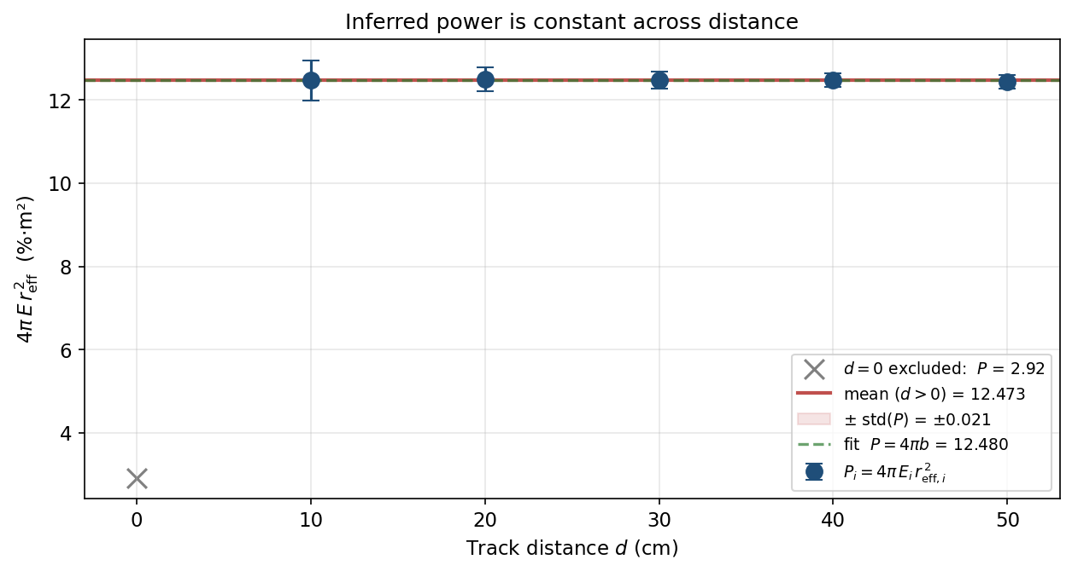
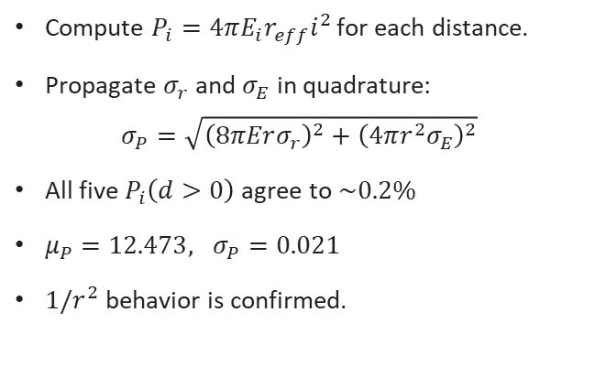
Is the Inferred Power Constant?
Per-point power
Compute $P_{i}=4πE_{i}r_{eff}i^{2}$ for each distance.
Propagate $σ_{r}$and $σ_{E}$ in quadrature:
$$σ_{P}=\sqrt{{\left(8πErσ_{r}\right)}^{2}+{\left(4πr^{2}σ_{E}\right)}^{2}}$$
All five $P_{i}\left(d>0\right)$ agree to $\sim 0.2\%$
$μ_{P}=12.473, σ_{P}=0.021$
$1/r^{2}$ behavior is confirmed.

Slide 9
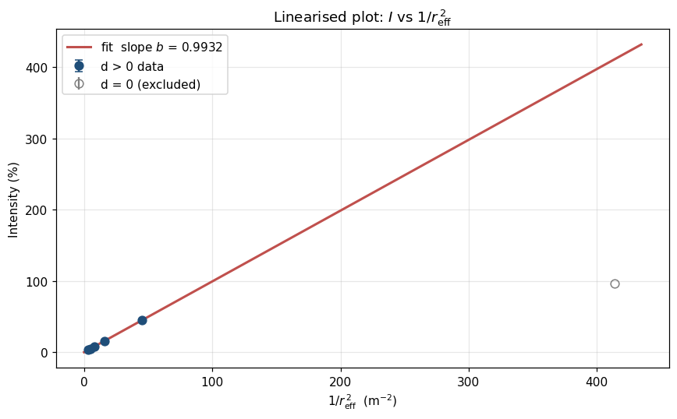

Linearization
If $I=b/r_{\text{eff}}^{2}$ holds, plotting $I$ against $1/r_{\text{eff}}^{2}$ should be linear through the origin with slope $b$

Slide 10
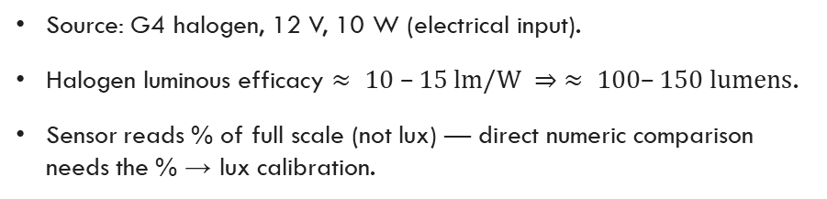
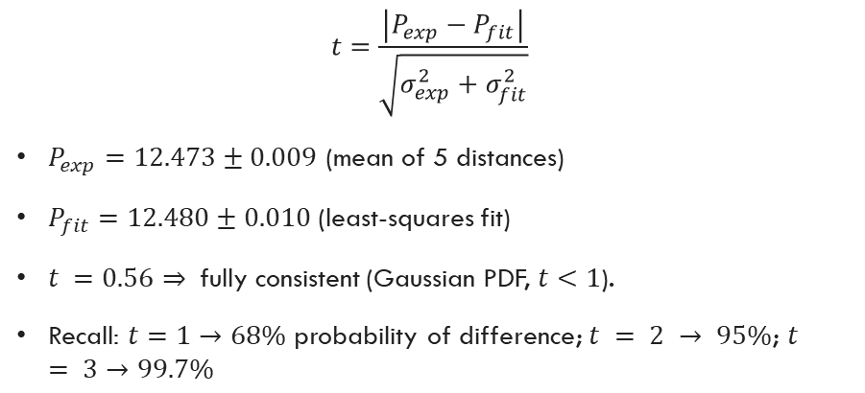
Comparison and Significance
t-test: cross-check vs fit
Sanity check vs source rating
$$t=\frac{\left|P_{exp}−P_{fit}\right|}{\sqrt{σ_{exp}^{2}+σ_{fit}^{2}}}$$
$P_{exp}=12.473±0.009$ (mean of 5 distances)
$P_{fit}=12.480±0.010$(least-squares fit)
$t =0.56⇒$fully consistent (Gaussian PDF, $t<1$).
Recall: $t=1→68\%$ probability of difference; $t = 2 → 95\%$; $t = 3→99.7\%$
Source: G4 halogen, 12 V, 10 W (electrical input).
Halogen luminous efficacy $≈ 10 –15 lm/W ⇒ ≈ 100–150 lumens$.
Sensor reads % of full scale (not lux) — direct numeric comparison needs the % → lux calibration.

Slide 11
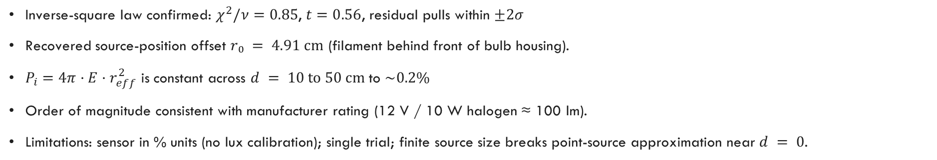

Conclusions
$P_{exp}=12.480±0.010 \%∙m^{2}$
$$r_{0}=4.92±0.01 cm$$
Gaussian PDF, 68% confidence level
Key findings
Inverse-square law confirmed: $χ^{2}/ν=0.85$, $t=0.56$, residual pulls within $±2σ$
Recovered source-position offset $r₀ = 4.91 cm$ (filament behind front of bulb housing).
$P_{i}=4π·E·r_{eff}^{2}$ is constant across $d = 10 to 50 cm$to $\sim 0.2\%$
Order of magnitude consistent with manufacturer rating (12 V / 10 W halogen ≈ 100 lm).
Limitations: sensor in % units (no lux calibration); single trial; finite source size breaks point-source approximation near $d = 0$.

